Slide 1

Graph Theory and its Applications
Dynamics : Herding and Diffusion
Dr. Arti Arya
Department of Computer Science
and Engineering

Slide 2

Graph Theory and its Applications
Types of dynamics in graph
Dr. Arti Arya
Department of Computer Science and Engineering

Slide 3
Graph Theory and its Applications Acknowledgement
The course slides are prepared by Prof. BhaskarJyoti. But various additional inputs are added by me from various reliable resources from Foreign and Indian Universities as well as from sites.
Notes:
Ok. Having said that, lets get back to what we were speaking about.
Input devices. We have seen that the virtual reality eco system largely encompasses three fundamental components that include
HMD – head mounted devices that give you immersive VR experience, we saw some examples in the last class like the HTC VIVE, Oculus Rift, Samsung gear and so on. Some of you have also used few of these and experienced it for a few minutes.
And the second components is the GTD or the Gesture Tracking Devices. We saw a video of Xsense IMU sensors that can accurately estimation the position and orientation of a dancer. we will in the next hour see how these gesture tracking devices work and what are the various technicalities that go into tracking. I will try to keep it as non-mathematical as possible, as the mathematics behind it can get pretty messy and complicated. However, if you are interested in the mathematical aspects, I will be more than happy to discuss.
On the screen you can see that a 3 directional coordinate system is depicted. The 3 primary axes of a 3d coordinate system is X, Y and Z axis. Hear I would like to know where, when and why in your past have you encountered 3 dimensional coordinate system.
Give some time to the students to ponder on
Ok, if I tell you, I have encountered 2 dimension in images, drawings, sketch and so on. While I have encountered 1 dimension when I want to know the temperature currently or current time or something like that. Similar, where and when have you encountered 3D, either consciously or subconsciously.
Explain the roll pitch and yaw concepts.
Degree of freedom

Slide 4
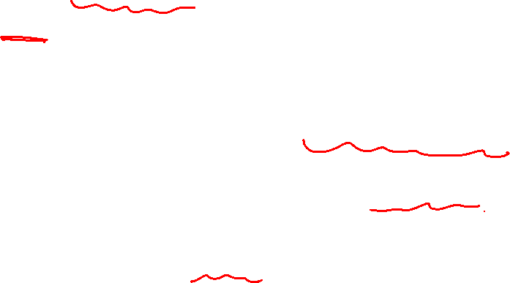
Dynamics in graph
Networks of different types :
Technological network : Communication network, road network etc.
Network of content : web , documents and media
Human networks : connecting people and organizations
So far we focused on static structure of the networks i.e. paths, clusters, prominent nodes
What we have NOT discussed so far is DYNAMICS in the social graph:
Cascade, Contagion, Evolution !!
Many things flow through networks ( traffic, information, disease , behaviour etc.) . We are now focusing on these !!

Slide 5
Dynamics in graph: Types of Information Diffusion
Types of Information Diffusion
Herd Behavior
Epidemics
Network is observable( Explicit)
Network is not observable
Cascade Behavior
Diffusion of Innovations
Network is observable but only local behavior of nodes is known
Network is not observable.
Connected to a new app but you are aware about other connections
https://www.google.com/search?q=Example+Story+for+Herding+behavior+in+networks&source=lnms&tbm=vid&sa=X&ved=2ahUKEwiGxoO5osT9AhV4-3MBHQaaCBkQ_AUoA3oECAEQBQ&biw=1280&bih=601&dpr=1.5#fpstate=ive&vld=cid:f79b8428,vid:0IJCXXTMrv8

Slide 6
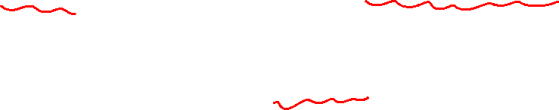
Network is explicit with full observability : herding
Network is observable – this can happen only with explicit network
Example: you are sitting in a class with your class-mates every day, we can say that NETWORK BETWEEN THE CLASS-MATES IS OBSERVABLE and it is EXPLICIT.
As Network is observable, behaviour of all nodes are visible (information is available about every node) to every other node.
Dynamics that can happen here is “herding”

Slide 7
Network is explicit but only with local (observability) : cascade
When the Network is observable but not all nodes. The node is aware only of the “local “ part of the network !!
Example (Network is explicit but only with local info) :
You know everything about your community ( sub-group of 5th semester students you hang-out with . There are other sub-groups with different likes and dislikes but you hardly know enough about them
Your group makes it a point to participate in group coding on weekends. Another group makes it a point to spend the weekend in teaching in orphanage
Will your group start spending weekend in the orphanage or will the other group start spending the weekend in group coding ?
If you want to convert the other group, will you target all the members or will you first target the leader of the group ( = who is connected to the rest of the members) ?
The conversion, if happening or happens, is called “Cascade” - network is explicit/observable but only local information is available.

Slide 8
Network is implicit with no information : diffusion of information
When the explicit network is NOT available and visible, the way you model it , need NOT factor in the network !!
Example
If we make a network based on the some new app that is getting adopted by the students in Bangalore, it is an IMPLICIT NETWORK ( edge means common usage)
Think of the new “Idli Mix” is getting launched in Bangalore . It is an implicit network that is not visible and no information is available about all the nodes !! But the company that launched the product need to estimate how many to manufacture to meet the needs
This kind of dynamics is DIFFUSION

Slide 9
Network is implicit with no information : Epidemics
Epidemic & Pandemic (epidemic over multiple countries)
Example ( COVID 19)
If you visit a crowded place, you may get COVID 19 if you come in contact with a carrier of that virus if “safe distance is not maintained”
You can draw an edge wherever there is a distance lesser than the safe distance
This is an IMPLICIT NETWORK with no information available !
If you are susceptible and the person carrying infection ( = infected) are connected through an edge (because there is a distance lesser than safe distance), you will get infected with COVID -19 with certain probability
This kind of dynamics is observed in “Epidemic” .
Notes:
Pandemic – pandemic means general or universal with a negative connotation
Epidemic – a
Endemic

Slide 10
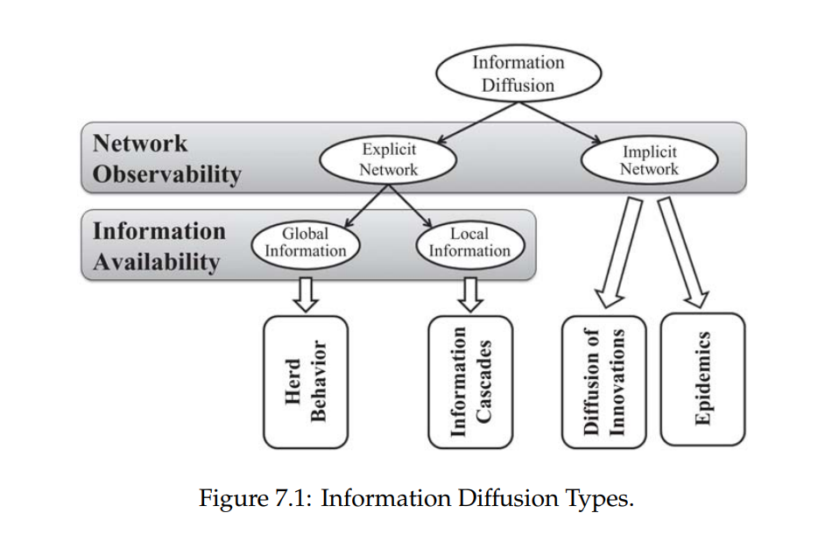
Types of dynamics or Types of Information Diffusions in networks

Slide 11
Herding
Dr. Arti Arya
Department of Computer Science and Engineering

Slide 12
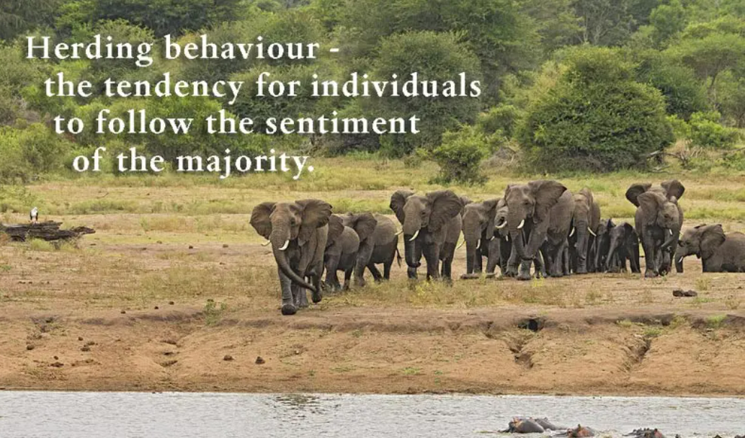
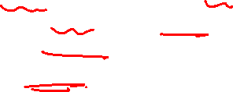
Herding Behavior
In network science, herding refers to the phenomenon where individuals in a network tend to conform to the opinions or behaviors of the majority, even if those opinions or behaviors are incorrect or irrational.
Janasamūhada manasthiti
ಜನಸಮೂಹದ ಮನಸ್ಥಿತಿ

Slide 13
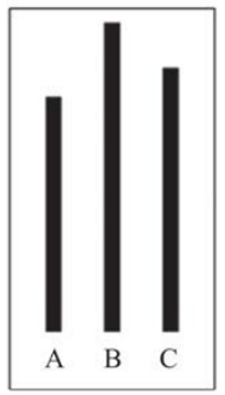
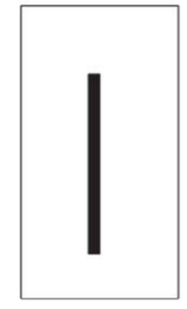
Solomon Asch Experiment: Example

Slide 14
Milgram’s experiment: Another Example
Stanley Milgram asked one person to stand still on a busy street corner in New York City and stare straight up at the sky.
About 4% of all passersby stopped to look up.
When 5 people stand on the sidewalk and look straight up at the sky, 20% of all passer by stopped to look up.
Finally, when a group of 18 people look up simultaneously, almost 50% of all passersby stopped to look up.

Slide 15
Intervention
In general, herd’s behavior network is close to a complete graph where nodes can observe most other nodes and they can observe public information.
Individuals make decisions by observing all other individuals’ decisions.
Herding may be intervened by releasing private information which was not accessible before.
The little boy in “The Emperor’s New Clothes” story intervenes the herd by shouting “he's got no clothes on”

Slide 16
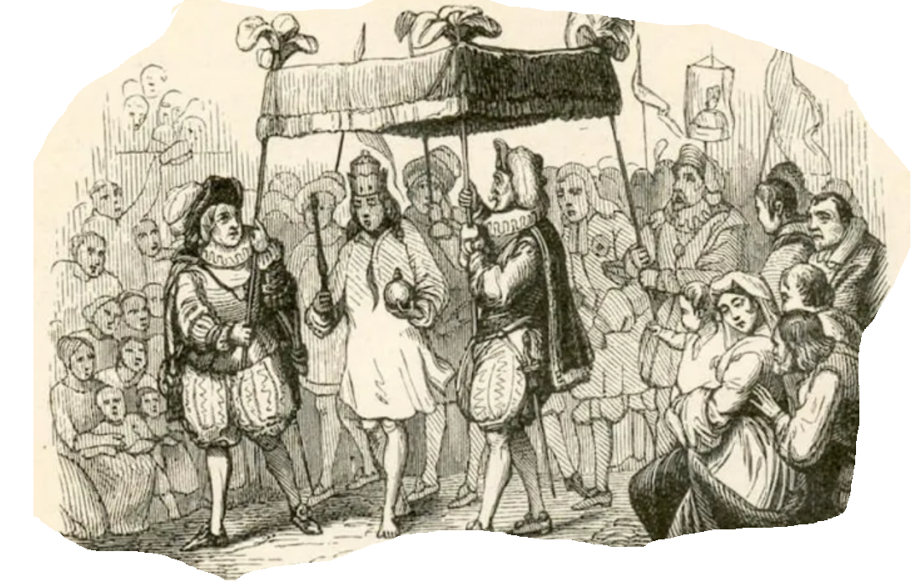
The Emperor’s New Clothes: Another Example
https://owlcation.com/humanities/EmperorsNewClothes

Slide 17
NETWORK ANALYSIS AND MINING
Intervention
In "The Emperor's New Clothes" story, the majority of the people in the herd were pretending that the emperor was wearing magnificent clothes, even though he was actually naked. The little boy's intervention disrupted this herding behavior by speaking out and expressing an opinion that was contrary to the majority.
From a network science perspective, the little boy's intervention can be described as a "disruptive influence" on the herd. His action challenged the existing norms and beliefs of the herd and introduced a new perspective that was not previously considered. This disruption may have caused some members of the herd to re-evaluate their own opinions and beliefs, leading to a potential shift in the overall behavior of the network.
Overall, the little boy's intervention in "The Emperor's New Clothes" story is a powerful example of how a single individual can disrupt herding behavior in a network by introducing a new perspective or idea. This disruption can lead to a shift in the overall behavior of the network, and highlights the importance of diverse perspectives and opinions in driving positive change.

Slide 18
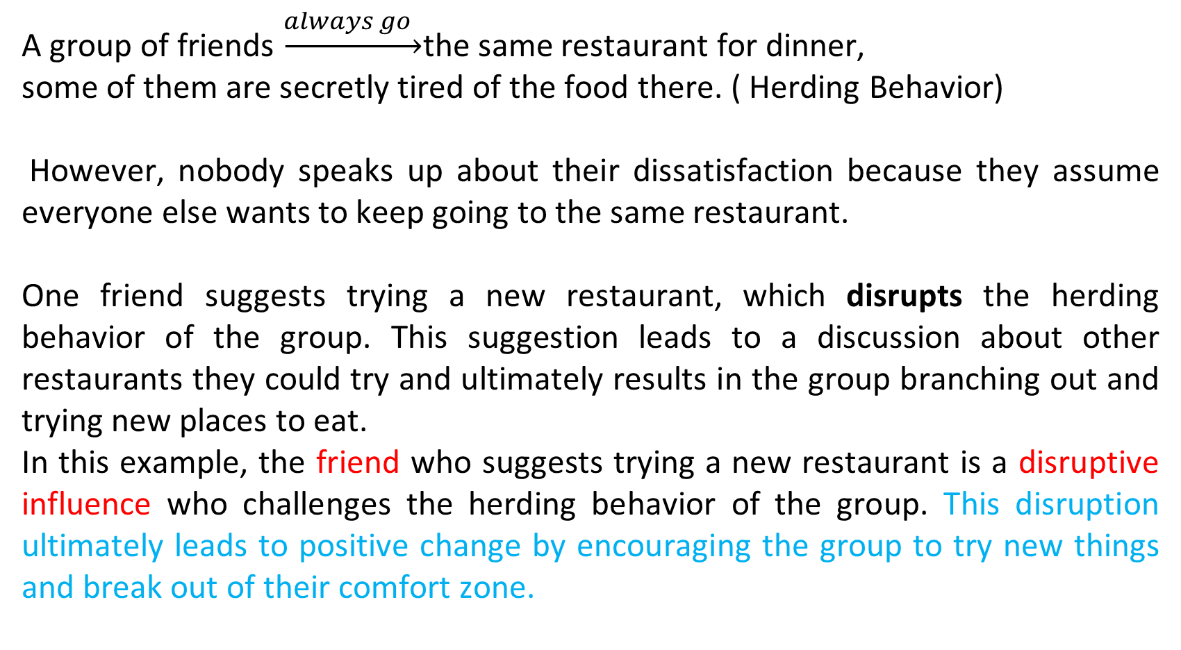
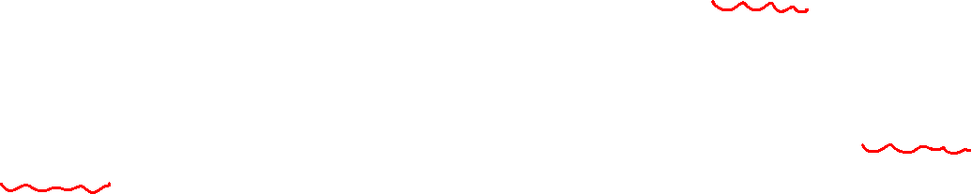
Intervention

Slide 19
Herding in online auction: Another Example
Individuals
can not only observe the bidding behaviors of others
but can also often view profiles of others to get a feel for their reputation and expertise.
In these online auctions, it is common to observe individuals participating actively in auctions, where the item being sold might otherwise be considered “not so great”. .

Slide 20
Cascading

Slide 21
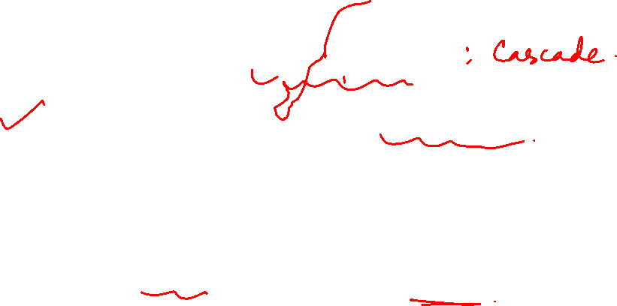
Modelling diffusion through a network
Individual choice depends on what other people do
Homophily was a basic assumption ( did not look further inside)
This helped use of information cascade, network effects and rich-gets-richer dynamics in modeling the way innovations get adopted by population
In this kind of analysis, two levels of granularity are possible
View network as an amorphous population of individuals and look at effects in aggregate
Move closer to fine explicit structure of network as a graph and look at how individual choice gets affected by neighbors in the graph
“Social Graph” behind Facebook’s valuation

Slide 22
What do we gain by this finer level of resolution ?
The second view addresses a number of phenomena that cannot be modeled well at the level of homogenous populations
Many of our interactions with rest of the world are at local rather than global level
Often we care more about decisions made by our immediate neighbours in the network than the decision by the overall population
Often we adopt political views that are locally majority but globally minority
Often we adopt technology that is locally popular but globally a failure

Slide 23
Cascade vs. Herding
An information cascade is defined as a piece of information or decision being cascaded among a set of individuals, where
1) individuals are connected by a network and
2) individuals are only observing decisions of their immediate neighbours (friends).
In cascading, local information is available to the users, but in herding the global information about the population is available.
A cascade develops when people abandon their own information in favor of inferences based on earlier people’s actions.
Individuals in a cascade are imitating the behavior of others, but it is not mindless imitation. Rational inferences are drawn from limited information.

Slide 24
Diffusion vs. Cascade
When we inject a new idea or new behaviour, it travels through the social network to different nodes with whom the “injected alter” has strong links. This is diffusion.
This trajectory of diffusion is cascade. When we refer “cascading behavior”, we are essentially modeling diffusion through a network.
Definition : A cascade of adoptions of behavior A from existing behavior B is a chain reaction of switches from B to A.

Slide 25
Studying dynamics – graph vs. game theory
An underlying structure of interconnecting links
Studied by graph theory
An interdependence in the behavior of individuals who inhabit the system, so that the outcome for any one depends on the combined behaviors of all
Studied via game theory

Slide 26
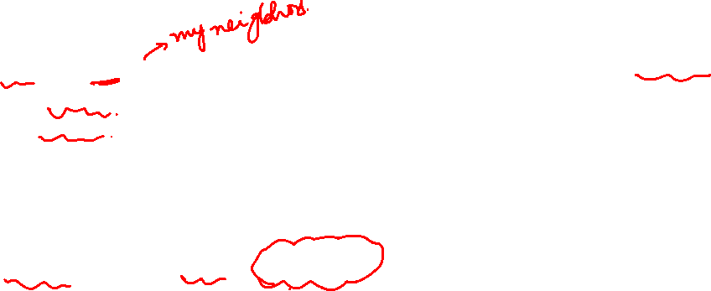
Rationale for Following the crowd
There are many rationale for an individual to imitate the choice of others
Information effects may entail making choice contrary to one’s own information i.e. restaurant choice.
Direct benefit effect depends on payoff
2 Rationale behind Following the crowd
Information Effects:
choices made by others can provide information about what they know
Direct-Benefits:
there are direct benefits from copying the decisions of others

Slide 27


Why we follow? It is payoff dude !
Because there is a pay off involved
Both you and friend are buying laptop and both have same budget
There is a payoff involved in each choice, we make an assessment of the payoffs and then makethe choice !
You
friend
Choice 1
Choice 2
Choice 3
Choice 4

Slide 28
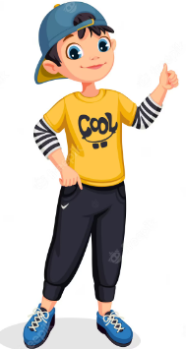
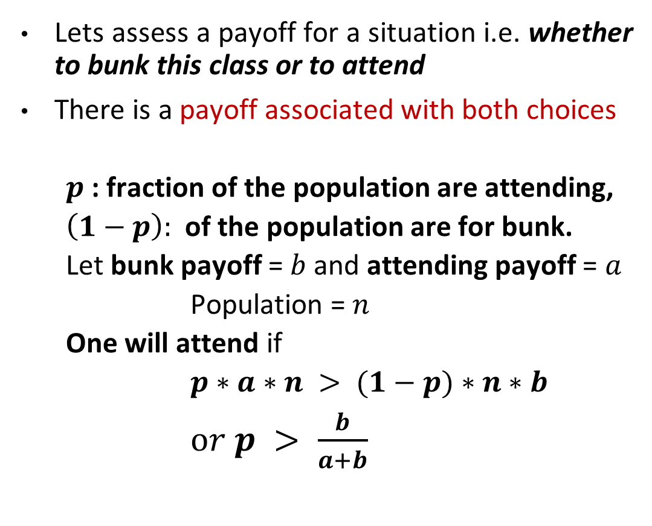
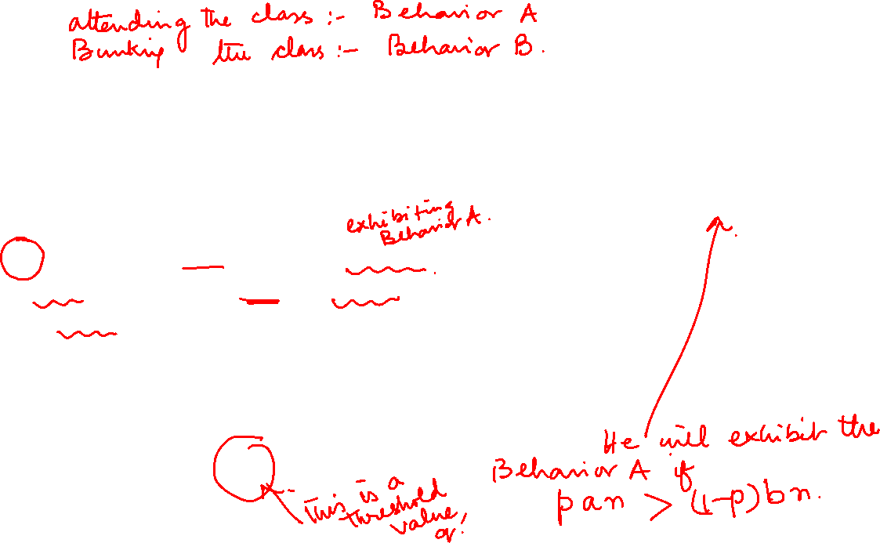
Calculate payoff in a network : direct benefit effect
attend
bunk
Here n=8

Slide 29
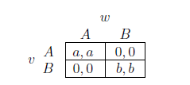
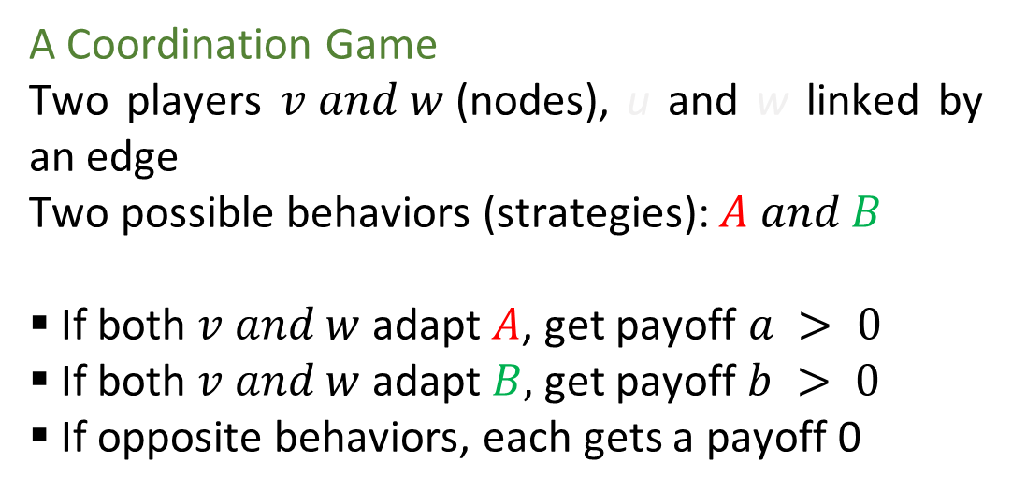
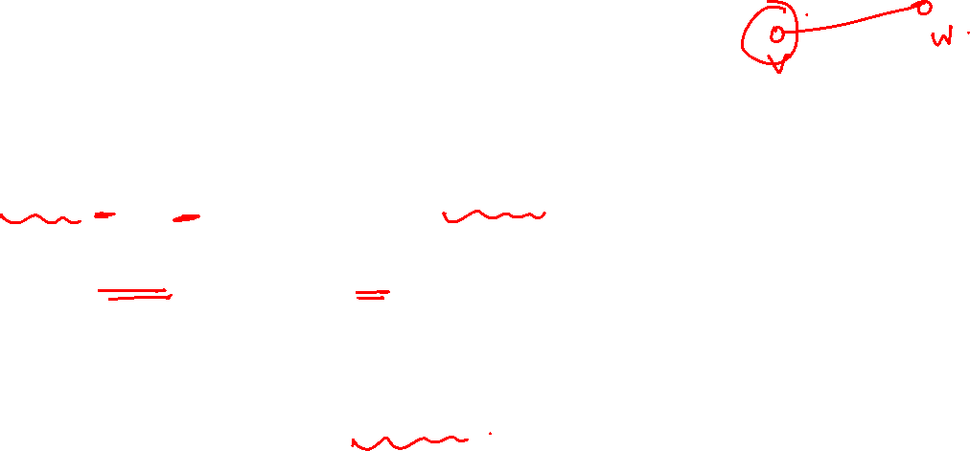
Simple model
An individual level model of direct-benefit effects in networks due to S. Morris
The benefits of adopting a new behavior increase as more and more of the social network neighbors adopt it

Slide 30
Basic idea of combining payoff
Each node –
plays the game with each neighbor
Payoff = sum of payoffs of each link
Consider node v –
Some neighbors adopt A
Some neighbors adopt B
So the maximum payoff of node v:
A node v should adopt A if at least a certain fraction of its neighbors follow A.

Slide 31
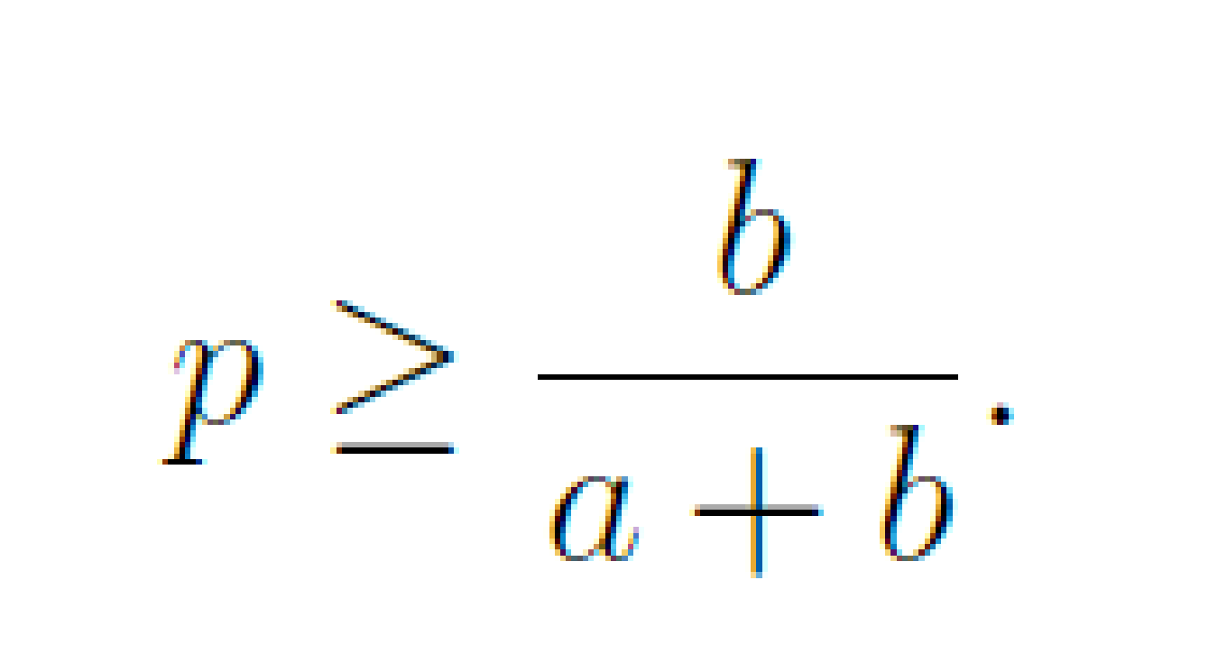
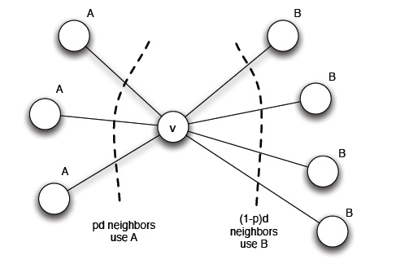
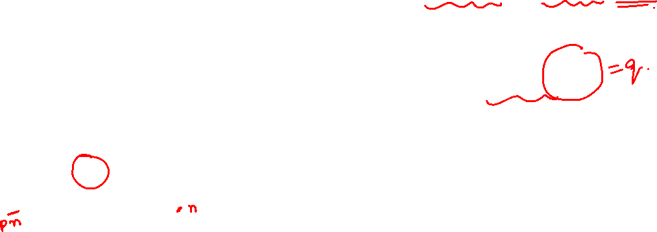
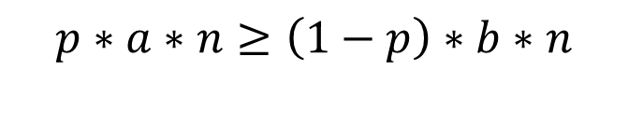
Networked coordination game: Payoff of node v
Each node v plays the same game with each of its neighbors
Its payoff is the sum of the payoffs in the games played on each edge
Hence v’s choice of strategy will be based on the choices made by all of its neighbors , taken together
A is a better choice if
After rearranging,
We call RHS as Threshold q for preferring A
$$p∗a∗n≥\left(1−p\right)∗b∗n$$
It is a myopic model of individual decision making (=immediate consideration only).
In a richer model, models will try to have more long range consideration !

Slide 32
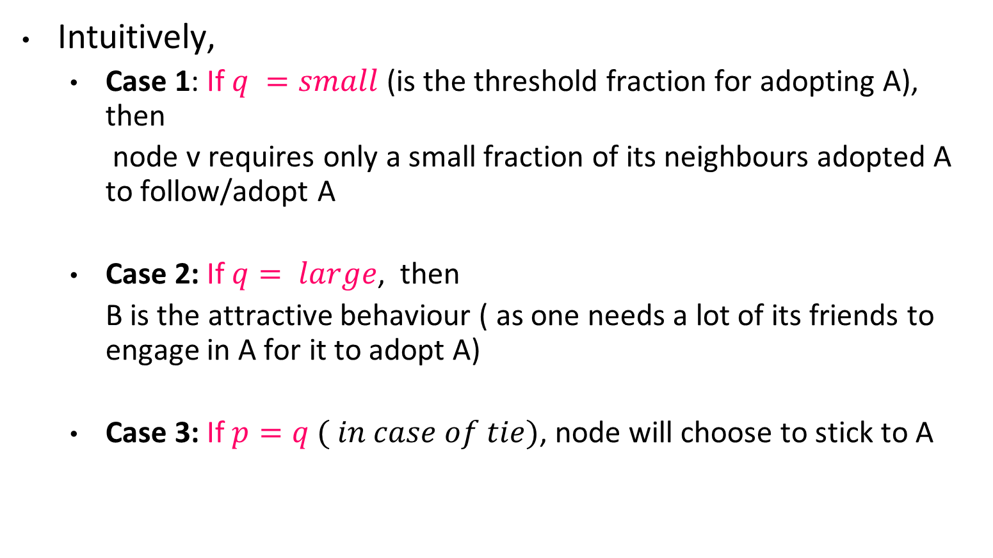
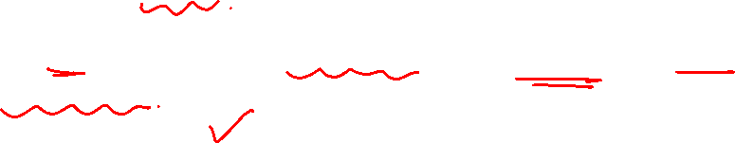
The myopic model of individual decision making

Slide 33
Social reinforcement playing a role …cascading behaviour
We originally decided to bunk
But more and more people decided to attend ( with b and a remaining the same ..)
Reason : payoff (for bunking) reached bottom
The ratio value changed
Now we decided to attend classes

Slide 34
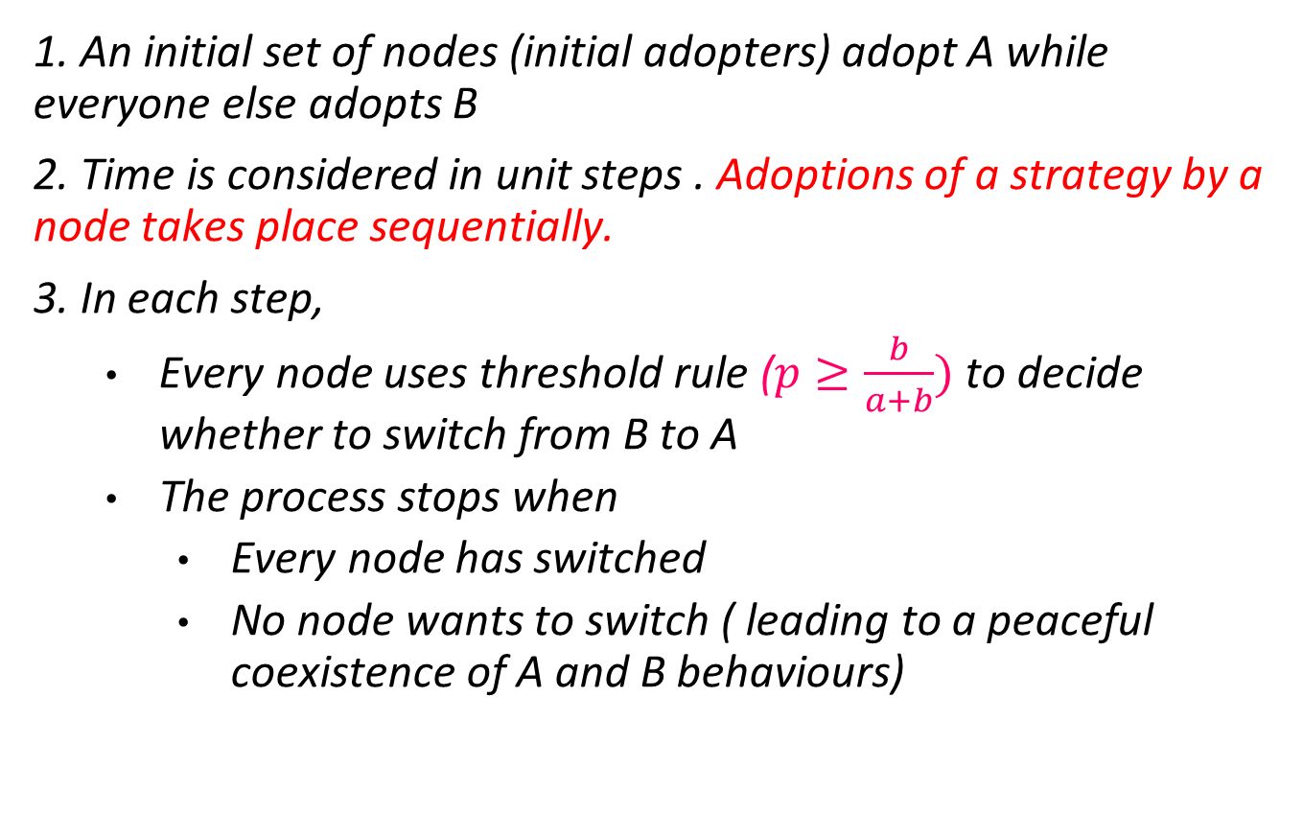
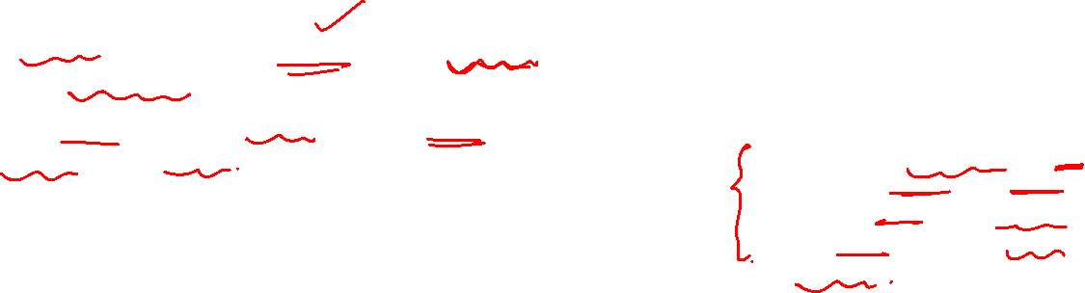
Modeling cascade
The largest value of the fraction ‘q’ that would still enable all the users in the network to adopt the same decision is called the cascading capacity of the network.

Slide 35
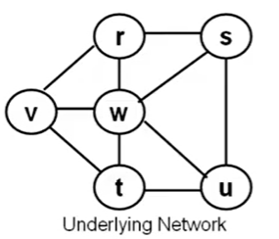
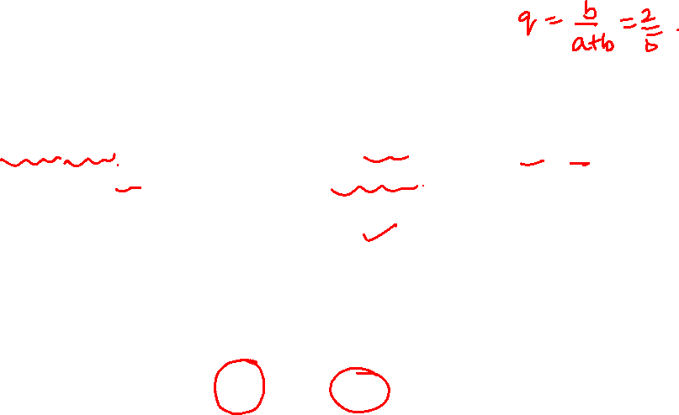
Cascading behavior – when everybody switches
The coordination game is set up as follows:
a = 3, b = 2, so q = 2/5 i.e. nodes will switch from B to A if at least a fraction q of their neighbors are using A
v and w are the early adopters
Step 2

Slide 36
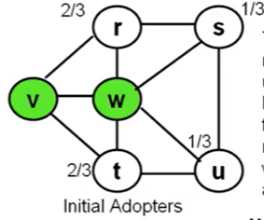
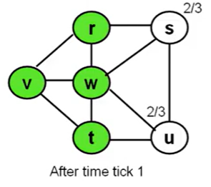
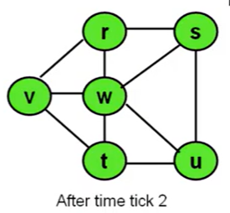
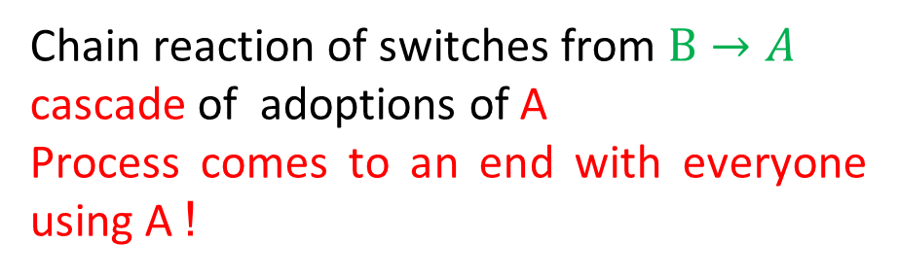
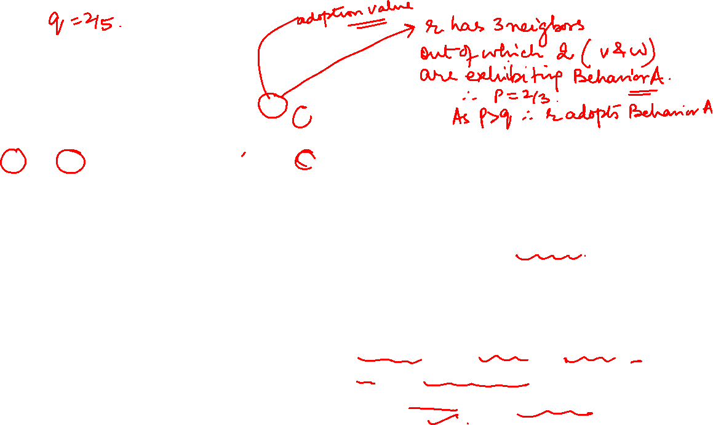
Cascading behavior – when everybody switches
A
A
A
(a)
(b)
(c )
Step 1
Step 2
(d )
Step 2

Slide 37
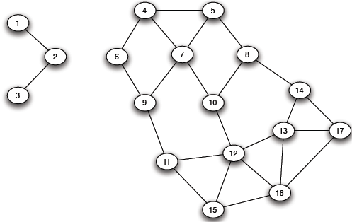
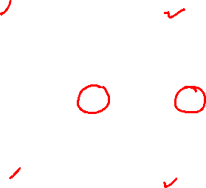
Cascading behavior – when everybody does not switch
Here, the game is set up for a = 3, b = 2, q (threshold) = 2/5. Nodes 7,8 are the early adopters

Slide 38
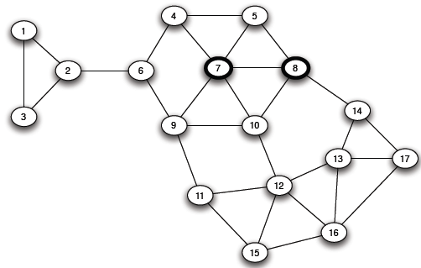
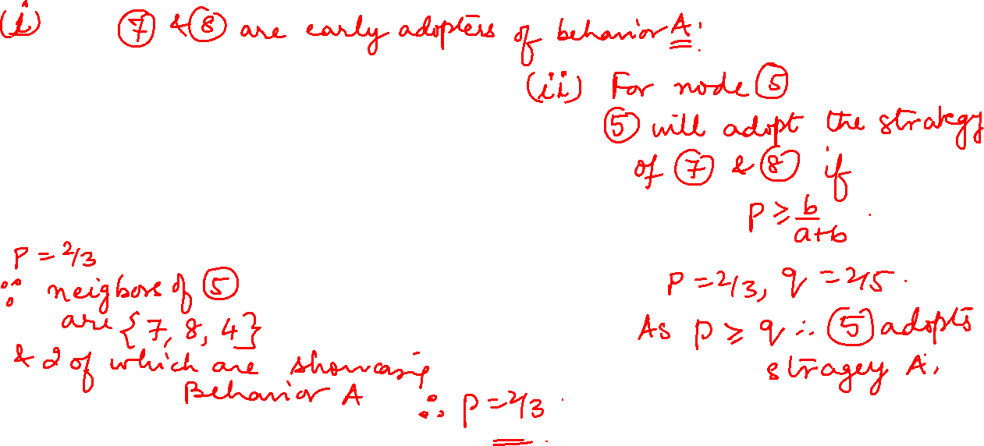
Cascading behavior – when everybody does not switch
(b)

Slide 39
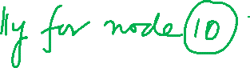
Cascading behavior – when everybody does not switch
Step 1 : nodes 5, 10 switch to A as 2/3 > 2/5

Slide 40
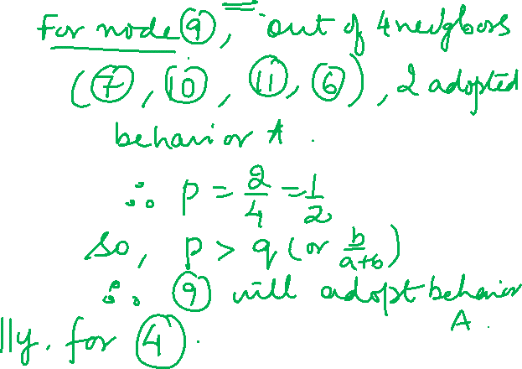
Cascading behavior – when everybody does not switch
Step 2 : 4,9 switch

Slide 41
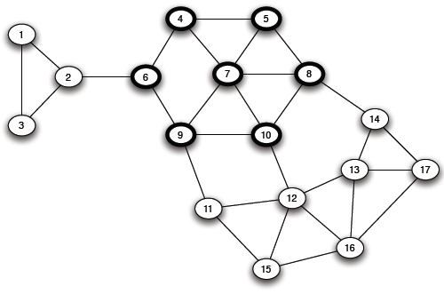
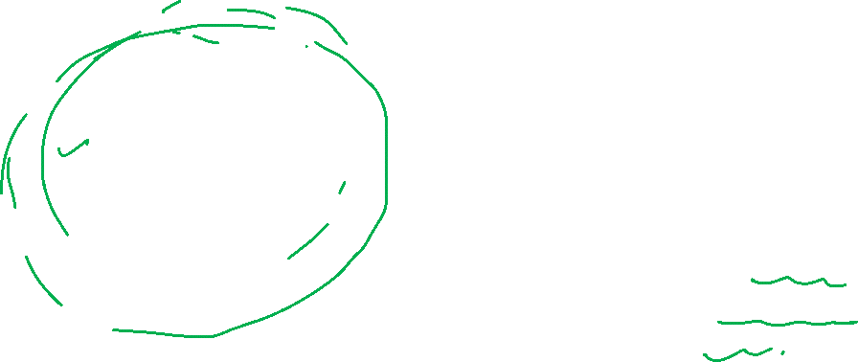
Cascading behavior – when everybody does not switch
Step 3 : 6 switch
At this no further node will be willing !

Slide 42
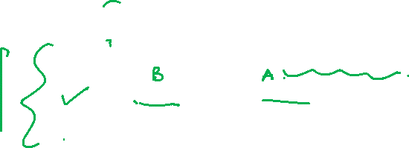
Three possibilities and defining complete cascade
At the end, three things can happen
All bunked or all attended . In the case all adopted behaviour A or all adopted behaviour B
A group bunked and another group attended
Definition : For a set of initial adopters who start with a new behaviour A while every other node starts with behaviour B . Nodes then repeatedly evaluate decision to switch from B to A using a threshold of q
If the resulting cascade of adoptions of A eventually causes every node to switch from B to A , we say that the set of initial adopters completed cascade at threshold q
Note that our discussion about co-existence of A and B along a natural boundary in the network depends not only on the network structure but also on the relative payoff of coordinating on A versus B

Slide 43
Cascading and virality
If we change the payoff a from a=3 to 4, b=1 then the threshold q (=b/a+b) for adopting A drops from 2/5 to 1/5 . This captures a scenario when making an existing innovation slightly more attractive greatly increases its network reach !!
If it is not possible to raise the quality of A, a different strategy will be followed to convince & convert a number of key people in the other network . choosing these key people is vital in viral marketing !!
In a population-based model, when everybody evaluate their adoption decision based on fraction of entire population that adopted the innovation, a new technology will never get started, even if it is better. However, the current model makes it possible as it looks to its immediate neighbors !

Slide 44
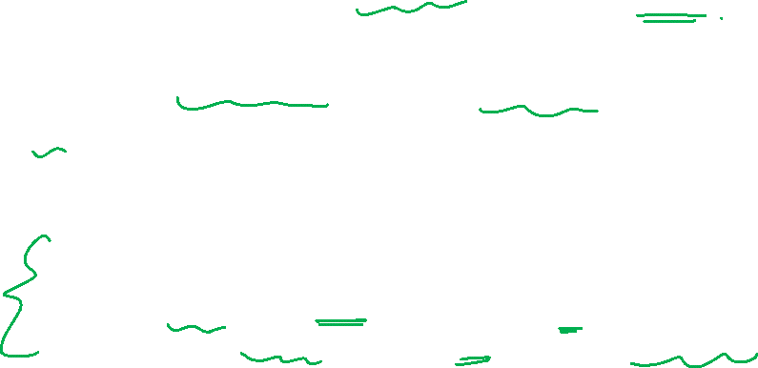
Suppose one community wants to influence the other community
Suppose I want to bunk and I want everybody to bunk the class.
What are the options ?
I can manipulate payoff in my favor
I can target key influencers in the other camp ( so that the p changes) and if they change sides, then the rest will follow !

Slide 45
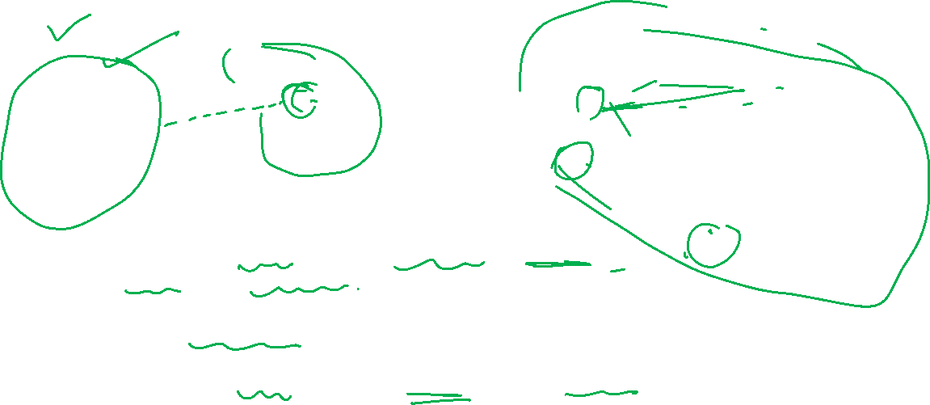
Suppose one community wants to influence the other community
Weak tie
Key member
Community on left wins over key member from other side, edge gets made and he is converted.
Next, the triadic closures happen and more edges get done !
More triadic closure will happen merging them into a single community !

Slide 46

Target Key Influencers
People are not changing over to “MamaEarth” ?
So, Ms. Shenaaz Gill is been roped in who has a very high number of followers on different platforms leading to early adopters in the rival camp
Disclaimer: The image is been used only for academic purpose and research

Slide 47
Cascade and Cluster

Slide 48
Coming back to Class Bunk example- Cluster and Cascade
If the class has strong communities (weak tie between the groups and strong tie within the group), then it will result in the 3rd possibility ( two groups bunk vs no-bunk)
(At the end, three things can happen
1. All bunked .(all adopted behaviour B )
2. All attended . (all adopted behaviour A)
3. A group bunked and another group attended
The groups or communities are too strongly tied within than with other communities
So, clustering can stop cascade.
attend
bunk
Here n=8

Slide 49
Modeling Cascade through a network
We want to understand the “intermediate” cases when A and B are both adopted in some parts
Suppose that
In a hypothetical network, initially everyone is using B as a default behavior
A small set of “initial adopters” decide to use A defying the payoff rule
Apart from these initial adopters ( who have switched to A for some reason other than the payoff rule), all other nodes follow “pay off “ rules
Question
When will this result in everyone eventually switching to A?
If this does not happen, what causes the spread of A to stop?

Slide 50
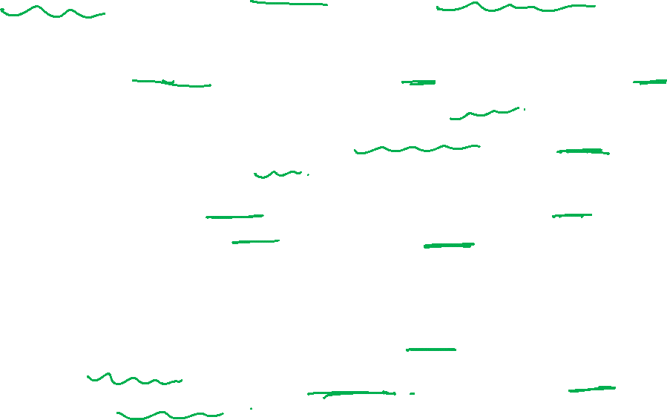
Complete Cascade:When will this result in everybody switching to A ?
A set of initial adopters who start with a new behavior A, while every other node starts with behavior B.
Nodes repeatedly evaluate the decision to switch from B to A using a threshold of q.
If the resulting cascade of adoptions of A eventually causes every node to switch from B to A, then we say that the set of initial adopters causes a complete cascade at threshold q.
The number of neighbors of a node that adopt A only increases with time. Hence, no node switches back to B after adopting A.

Slide 51
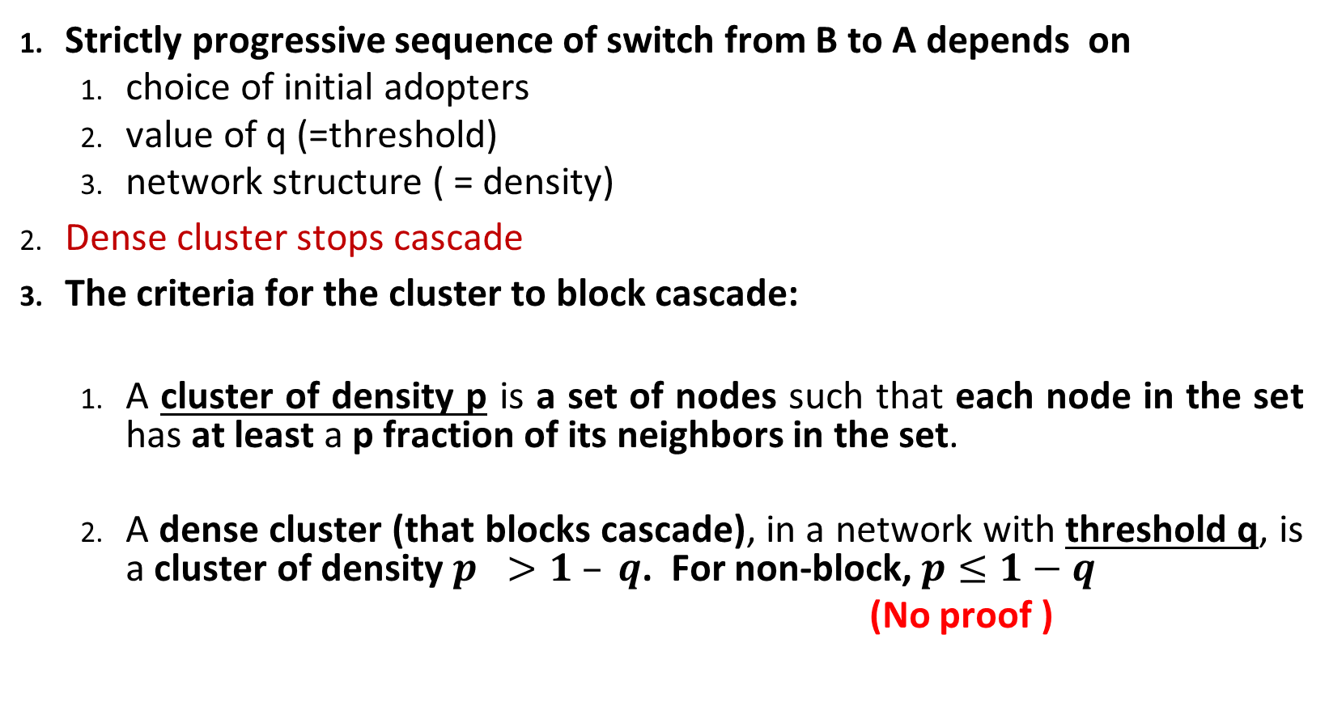
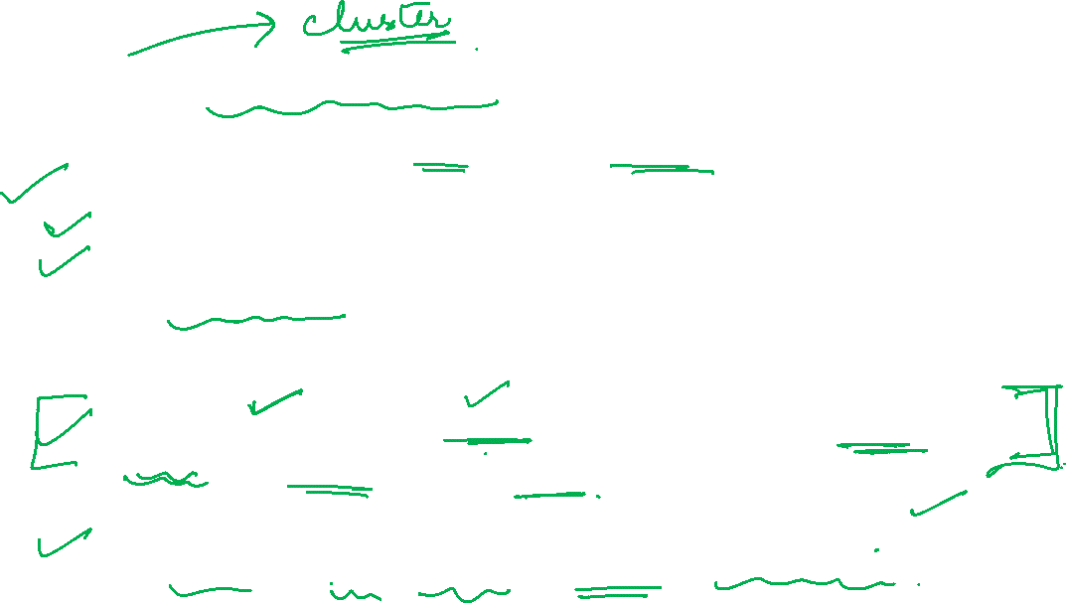
What causes spread of A to stop ?

Slide 52
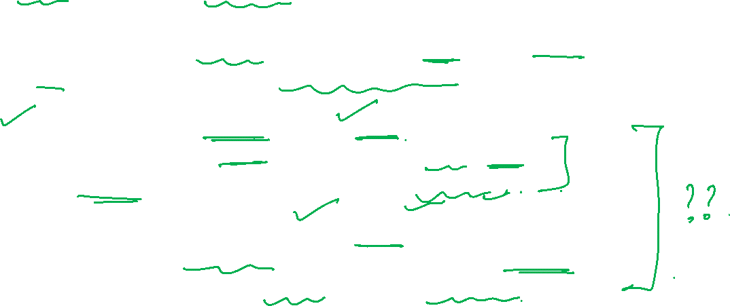
Homophily can serve as a barrier
Claim: Consider a set of initial adopters of behavior A, with a threshold q for nodes in the remaining network to adopt behavior A.
Theorem 1 : (clusters as obstacles to cascades)
If the remaining network contains a cluster of density > 1 − q =>
the set of initial adopters will not cause a complete cascade.
(ii) Theorem 2 : (clusters are the only obstacles to cascades)
Whenever a set of initial adopters does not cause a complete cascade =>
the remaining network contains a cluster of density > 1 − q.

Slide 53
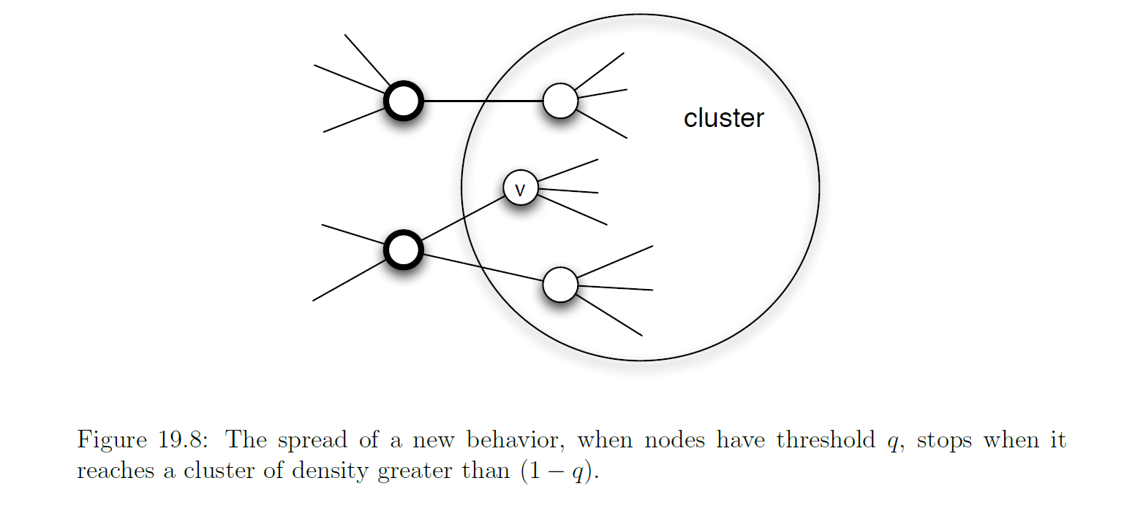
Indirect proof – clusters are obstacles to cascade
Proposal : Behaviour A is spreading with threshold q. Remaining network contains a cluster of density greater than 1-q. We will argue that no node inside cluster will adopt A

Slide 54
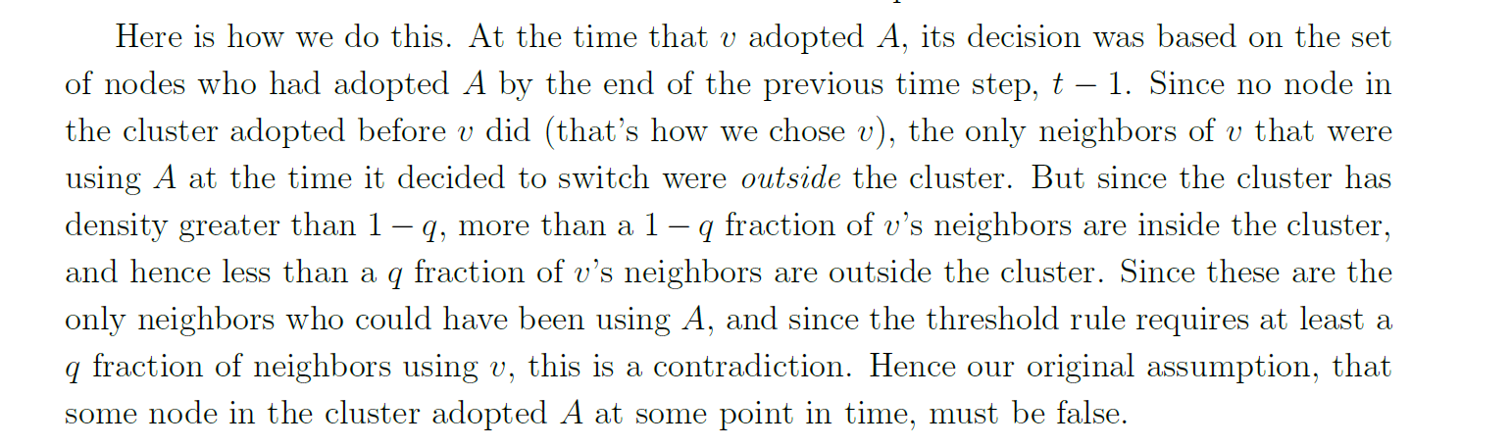
Indirect proof – clusters are obstacles to cascade
Essentially we want to argue that at the time when v adopted A, it could not possibly have had enough neighbours using A to trigger is threshold rule. This will contradict what we started with : v adopted A

Slide 55


Indirect proof – clusters are the only obstacles to cascade

Slide 56

Indirect proof – clusters are the only obstacles to cascade

Slide 57


Cluster and cluster density
A cluster of density p is a set of nodes such that every node in the set has at least a p fraction of its neighbors in the cluster itself
Similarly for other 2 clusters
{ a, b , c, d} is a cluster of density p=2/3.
Every node of the cluster has the following neighbors:
Nghb. of a= {b,c}
Nghb. of b= {c, d, a}
Nghb. of c= {b, a , d}
Nghb. of d= {b,c, e}
Neighbors of a, b, c are 100% in the cluster and neighbors of d are such that 2/3rd of them are in the cluster so density=2/3

Slide 58

Cluster and cluster density
By this definition, in any network, set of all nodes is always a cluster of density 1 (as all neighbors reside in the network).
The union of any two cluster of density q is also a cluster of density at least q .
Diffusion happens easily within the cluster but may not happen easily across . The strategy should be to distribute the adopters across clusters

Slide 59


An example
Threshold (q) = 3/5
Hence both clusters will block cascade

Slide 60


Cascade and cluster : extending the previous example
Cluster {1, 2, 3} : few nodes have 2/3 and rest have 1 as density i.e. at least 2/3. Hence it will also block

Slide 61

Cascade and cluster : extending the previous example
Here, the game is set up for a = 3, b = 2, q (threshold) = 2/5
So cluster of density greater than (1-2/5) = 3/5 will block the spread at threshold 2/5
Nodes 7,8 are the early adopters
(b)
(a)
Note :
Nodes 4,9 aware of A but took longer to adopt A
Aware but not adopted
1,2,3 is a cluster of density 2/3 which is greater than 3/5 = (1-2/5)
Node 11,14 -> 2/3, 13,15,16,17 ->1,12->4/5 ; so density is 2/3 which is again greater than 3/5
Step 1 : nodes 5, 10 switch to A as 2/3 > 2/5
Step 2 : 4,9 switch
Step 3 : 6 switch
At this no further node will be willing !
(c )
Step 3

Slide 62


Weak ties : awareness vs. adoption
Consider a case with a threshold of q= 0.5
W and X are initial adopters of behavior that is spreading with q=1/2 .
The edges u-w and v-w are edges that are spanning across tightly knit communities.
The cascade will block as the adjacent clusters are of density (p) = ¾ which is > 1-q = 1/2
q (threshold) = 1/2

Slide 63
Weak ties : awareness vs. adoption
Interpretation :
For high threshold behavior ( like q=0.5),
a (local)bridge may connect you to somebody whose network neighborhood has caused them to settle on a different behavior !!
q (threshold) = 1/2

Slide 64
Weak ties are kind of double edged !
When cascade happens, a node in the same “cluster” may be “aware” but “not adopting” because it’s threshold i.e. b/(b+a) is not exceeded !
Across the clusters, the node on the other side of the weak tie may be “aware” but “not adopted” because the cluster density is too high !
Weak ties are great to convey awareness of new things but weak in cascade.
Weak ties are kind of double-edged that way

Slide 65

What happens if every node has a separate threshold ( heterogeneous) ?

Slide 66
What happens if every node has a separate threshold ( heterogeneous) ?
Across cluster :
Blocking cluster redefined : a blocking cluster is a set of nodes for which each node v has more than 1-q_{v} fraction of its friends in the cluster. Note that it is different for each node.

Slide 67



Heterogeneous network and pluralistic ignorance
Each person has a personal threshold which encodes her willingness to participate in a protest
A threshold of k means that she will participate if at least k people in total (including herself) will participate ( not telling k fraction explicitly)
Each person in the network has the knowledge of thresholds of her neighbors but not beyond
w will never join, since there are only 3 people and asking for 4
v will not as it knows of w asking for 4
u will not as it knows of w asking for 4
u knows of v and w but v and w does not know of each other ;
So is the case between v, w, x
So is the case of u, w, x
So none will participate as two of the three nodes are unaware of each other
u,v,w can participate because any one of them knows of the other two
x will not participate

Slide 68
Collective action and pluralistic ignorance - example
A collective action problem: A topic (organizing a protest) that integrates network effects at both the population level and the local network level
population level effect : an activity produces benefits only if enough people participate.
local network effect : Most will not participate as they don’t know that others would do
Pluralistic ignorance: a situation in which people have wildly erroneous estimates about the prevalence of certain opinions in the population at large (lack of knowledge)
This is why repressive governments limit communications (to prevent cascade)

Slide 69
Collective action and pluralistic ignorance - example
Pluralistic ignorance can happen in various situations, such as in the classroom, at the workplace, or in politics.
For example, a student may not understand a complicated lecture, but assume that everyone else does, so they do not ask questions or seek help.
A worker may disagree with a company policy, but think that everyone else supports it, so they do not voice their concerns or suggest alternatives.

Slide 70
Pluralistic Ignorance vs Common Knowledge
Common knowledge opposite of pluralistic ignorance
Not just transmit a message, but also make the listeners or readers aware that many others have gotten the message as well (Apple Macintosh introduced in a Ridley-Scott-directed commercial during the 1984 Super Bowl)
Post IRAQ war – structure of religious infrastructure enabled Shia community to generate common knowledge through the hierarchy of mosques and achieve coordination on a national scale as opposed to Sunni community
Social networks allow individuals to base decisions on what others know and on how they expect others to behave as a result

Slide 71

Diffusion of Innovations

Slide 72

Diffusion of innovation
An innovation is “an idea, practice, or object that is perceived as new by an individual or other unit of adoption”
The theory of diffusion of innovations aims to answer why and how these innovations spread.

Slide 73


Diffusion of innovation : the process
Awareness
The individual becomes aware of the innovation, but her information regarding the product is limited
Interest
The individual shows interest in the product and seeks more information
Evaluation
The individual tries the product in his mind and decides whether or not to adopt it
Trial
The individual performs a trial use of the product
Adoption
The individual decides to continue the trial and adopts the product for full use

Slide 74

Diffusion of innovation ( Everette M Rogers)
Innovators : Willing to take risks. These are people who want to be the first to try the innovation. (2.5%)
Early adopters : They are leaders who are already aware of the need to change and so are very comfortable adopting new ideas (13.5%)
Early Majority : They are not leaders but they typically need to see evidence that the innovation works before they are willing to adopt it(34%)
Late Majority : These people are skeptical of change and will only adopt an innovation after it has been tried by the majority. (34%)
Laggards : Conservatives, very skeptical of change and are the hardest group to bring on board. (16%)

Slide 75


Diffusion of innovation ( Everette M Rogers)
Adoption Life Cycle
Adoption Rate
https://www.youtube.com/watch?v=NCRNZe0tNDs

Slide 76


Adopter categories and S curve
Cumulative Adoption Rate
Adoption Rate

Slide 77


Geoffrey Moore – Crossing the chasm
Technology adoption life cycle is flawed !
There are actually big gaps where fledgling startups can fall flat
Cause of this adoption gap : Technology enthusiasts, Visionary (see exponential benefits and want to influence technology to shape it) , pragmatist (only when there is proven benefit), conservative ( adopt only when loss in not adopting), skeptics ( adopted only when forced)
“Social Graph” behind Facebook’s valuation

Slide 78

Geoffrey Moore – Crossing the chasm
As a software start-up, one BIG challenge is crossing the chasm.
The chasm refers to the technology adoption lifecycle or the transition from the early market into the mainstream market.
Early adopters are willing to test new technology in order to establish trends; they are willing to try something new and unproven.
And, the Early and Late majority of users who will embrace your product are far more risk-averse. They need confirmation that the goods will benefit them.
“Social Graph” behind Facebook’s valuation

Slide 79

Adopter cycle, chasm and hype cycle
“Social Graph” behind Facebook’s valuation

Slide 80
Bass model of diffusion

Slide 81

Bass Diffusion Model - Introduction
The Bass diffusion model is one of the most thoroughly researched models in market forecasting.
The model has proven to be versatile in representing the different patterns of adoption of products — from “sleepers”, where the sales pick up is gradual, to the “blockbusters”..
The Bass Model designed to answer the question: How many customers will eventually adopt the new product and when?

Slide 82

Bass Diffusion Model – Classic Use Case
Bass diffusion model is a classic way to predict sales for newly launched product in the market.
After launching a new product in the market, sales prediction for it has always been a difficult task due to lack of historical data.
It helps in making overall strategy for the product like determining the time for markdown, promotion and introduction of an updated version of the product in the market.

Slide 83

Diffusion: Bass Model
Based on the purchases of a consumer durable over time, Bass (1969) distinguished between two types of buyers:
Two types of Buyers
Imitators
Innovators
Innovators are not influenced in the timing of their initial purchase by the number of people who have already bought the product,
Imitators are influenced by the number of previous buyers. Imitators “learn” in some sense, from those who have already bought.
Notes:
imitation: the act of copying or imitating someone or something
imitation: something that is made or produced as a copy

Slide 84

Diffusion: Bass Model
The innovation coefficient(p):
p : innovators in the population. (rate of spontaneous innovation )
p reflects the extent to which adopters are influenced by their own intrinsic tendency to innovate and by factors beyond the population (including members of other populations and influences from “mass media” that affects all the populations).
The imitation coefficient(q): (rate of imitation due to social influence)
q : represents the extent to which the adopters emulate other members of the same population.
Notes:
imitation: the act of copying or imitating someone or something
imitation: something that is made or produced as a copy
Emulate – imitate

Slide 85

Bass model – Frank M Bass, 1963
Consider discrete time period t and let F(t) be the fraction of agents in a society who have adopted a new product or behaviour at time t
How to model F(t) i.e. a relation between F(t) and F(t-1)?

Slide 86
Bass model basics
Bass model is given by the difference equation

Slide 87

Bass model basics
Bass model is given by the difference equation
F(t) = F(t-1) + p ( 1- F(t-1)) + q(1- F(t-1)) F(t-1)
(1- F(t-1)) is the fraction of people who have not yet adopted
p(1-F(t-1)) = rate of innovation * fraction of people who have not yet adopted
(1- F(t-1)) can imitate F(t-1) at the rate q
Solving this when p > 0 and with an initial condition that F(0) = 0, leads to an expression of F(t)
Bass Model has undergone lot of improvements but still packs lot of insight.

Slide 88

Assumptions
Diffusion process is binary ( either consumer adopts or don’t adopt)
Maximum number of potential adopters or buyers is fixed.
All potential adopters eventually purchase/adopt.
Repeat purchases are not accounted for.
The impact of WoM is independent of adoption time.

Slide 89





Another version of BASS Model: `Assumptions

Slide 90



Diffusion: Bass Model: Another Representation
The other representation of the Bass Model is described by
Solving this when p > 0 and with a condition that F(0) = 0, leads to an expression of
As the parameters p and q are varied, the Bass model can fit a wide variety of diffusion curves.
Note that the ratio of q to p is the critical parameter that determines the overall shape of the curve.
Notes:
There are other representations of the Bass Model using different symbols and what may seem to be a different equation

Slide 91



Diffusion: Bass Model
http://faculty.washington.edu/sundar/NPM/BASS-Forecasting%20Model/Bass%20Model%20Technical%20Note.pdf

Slide 92

Why Bass Model gives S curve ?
S-shaped adoption curve : Bcoz diffusion begins slowly, then accelerates, and then eventually slows down and asymptotes.
Bass model can exhibit the S-shape. Note that initially there no imitation agents in the population to imitate.
The first adopters are almost entirely those who adopt from their own spontaneous innovation
As the process progresses, there are more agents around to be imitated and this leads to an increase in the rate of diffusion since now agents adopt through imitation as well as innovation.
There is a balance that occurs as the process progresses, since there are more agents around worth imitating, but fewer around to do it .
Eventually, the process has to slow down simply because there are no longer agents left around who might innovate or imitate.

Slide 93



Bass model yields S curve

Slide 94


Bass model yields S curve

Slide 95


Bass model yields S curve

Slide 96


Different Values for p and q for a fixed market size

Slide 97

Limitations in Bass model
Coefficient estimation of the model needs some past data of the product. However, it might be too late for the business to take any decision by the time the data is available
This may apply for yearly data, but is rarely valid for monthly or quarterly sales data which fluctuates due to causal factors like promotions and advertising.
The basic model assumes that market potential is fixed. This is not true because elements of the marketing mix such as price, advertising, distribution and product keep changing.
A prime forecasting objective for marketers is to assess the potential market of a product. Where sales data is not available, we have to rely on other heuristics or estimates diluting its utility
Does not allow for repeat or replacement purchase or cannibalization of products

Slide 98

Effect of social network on diffusion – Centrality
Centrality
Average degree - The impact of the number of ties on growth is straightforward: All else being equal, more ties per node lead to faster takeoff !
Two facets of degree distribution have been studied:
Some of the initial adopters are nodes with low connectivity, who do not promote the growth process. (The first is the level of heterogeneity, namely, the width of the distribution. Wider degree distributions have been shown to be associated with higher critical mass required for takeoff (Jackson & Yariv, 2005),)
The second is the extent to which the distribution is right skewed, a characteristic that reflects the proportion of highly-connected nodes, or so-called social hubs, versus nodes with less connectivity. Nodes with a small number of ties impede growth performance whereas hubs help !
(a hub is a node with a number of links that greatly exceeds the average)

Slide 99

Effect of social network on diffusion – Centrality
https://www.sciencedirect.com/science/article/pii/S0167811618300284

Slide 100

Effect of social network on diffusion - Clustering
Clustering has the potential to influence innovation performance in two opposing ways
On one hand, in a network with a relatively high level of clustering, each member is more likely to receive communication on the innovation from multiple network members, hence increasing awareness and concentrating peer influence and learning rate.
(it can create a supportive environment for the exchange of information and knowledge among organizations and individuals within the cluster. This can facilitate the spread of new ideas, products, or practices, leading to faster adoption and diffusion of innovation.)

Slide 101

Effect of social network on diffusion - Clustering
Clustering has the potential to influence innovation performance in two opposing ways
On the other hand, higher clustering increases redundancy, renders each tie less important on average, and compromises the network’s learnability .
(can lead to groupthink, which occurs when individuals within a group conform to the group’s dominant ideas, resulting in a lack of creativity and diversity of thought. This can lead to a reluctance to adopt new ideas or practices, and may slow down the diffusion of innovation within the cluster.)

Slide 102


1. https://solvinnov.com/innovation-diffusion-and-what-network-topology-can-tell-us/

Slide 103

THANK YOU
Dr. Arti Arya
Department of Computer Science and Engineering

